Slide 1
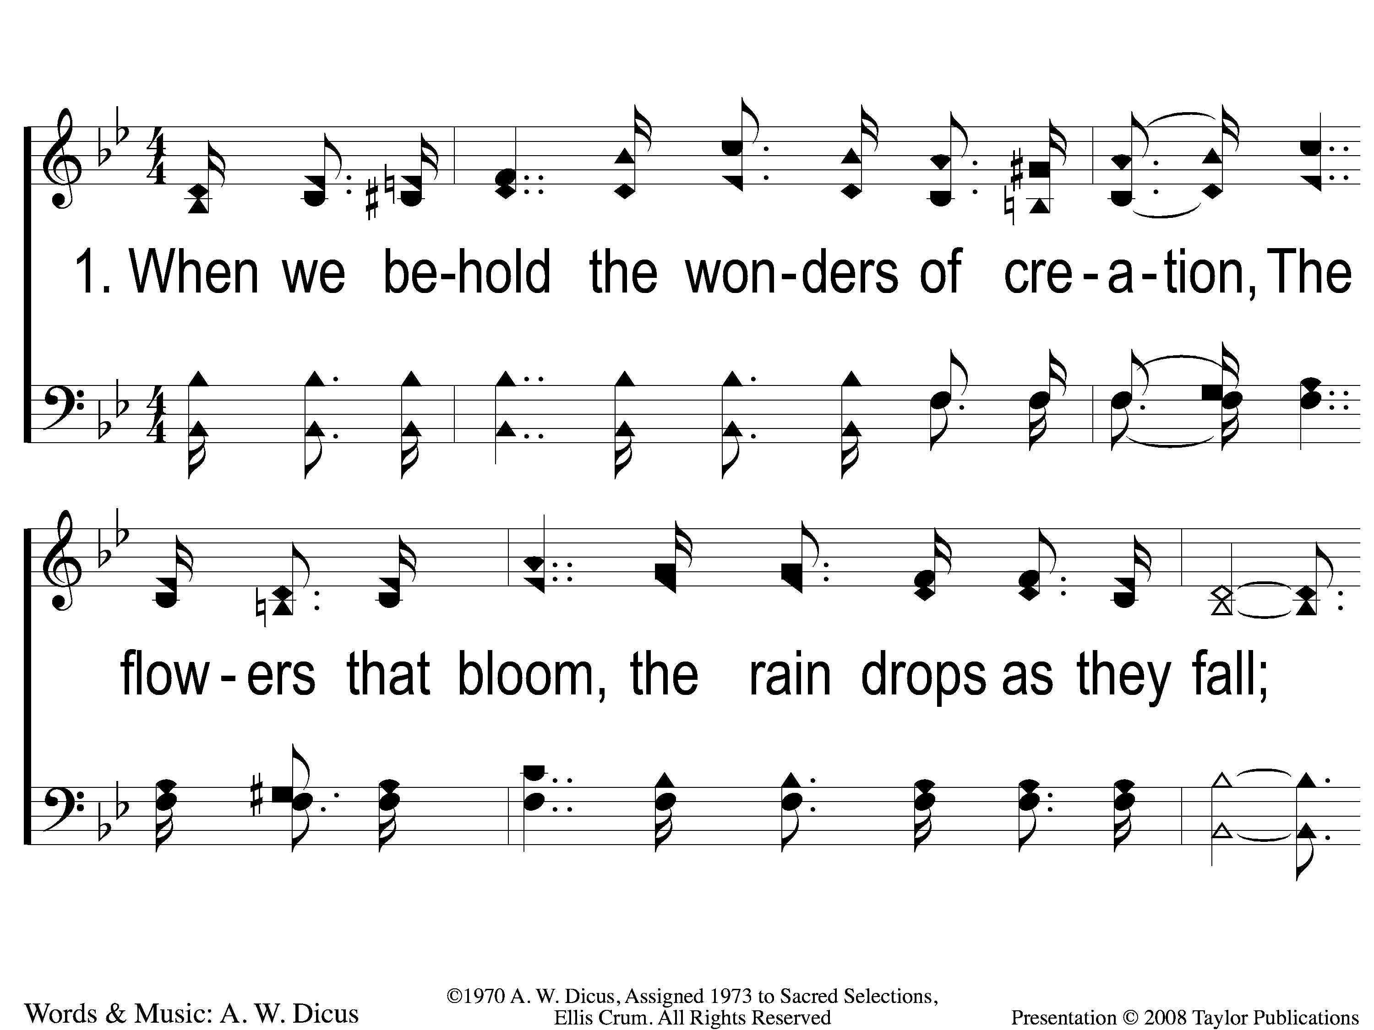
1-1 Lord I Believe
Lord, I Believe
75

Slide 2
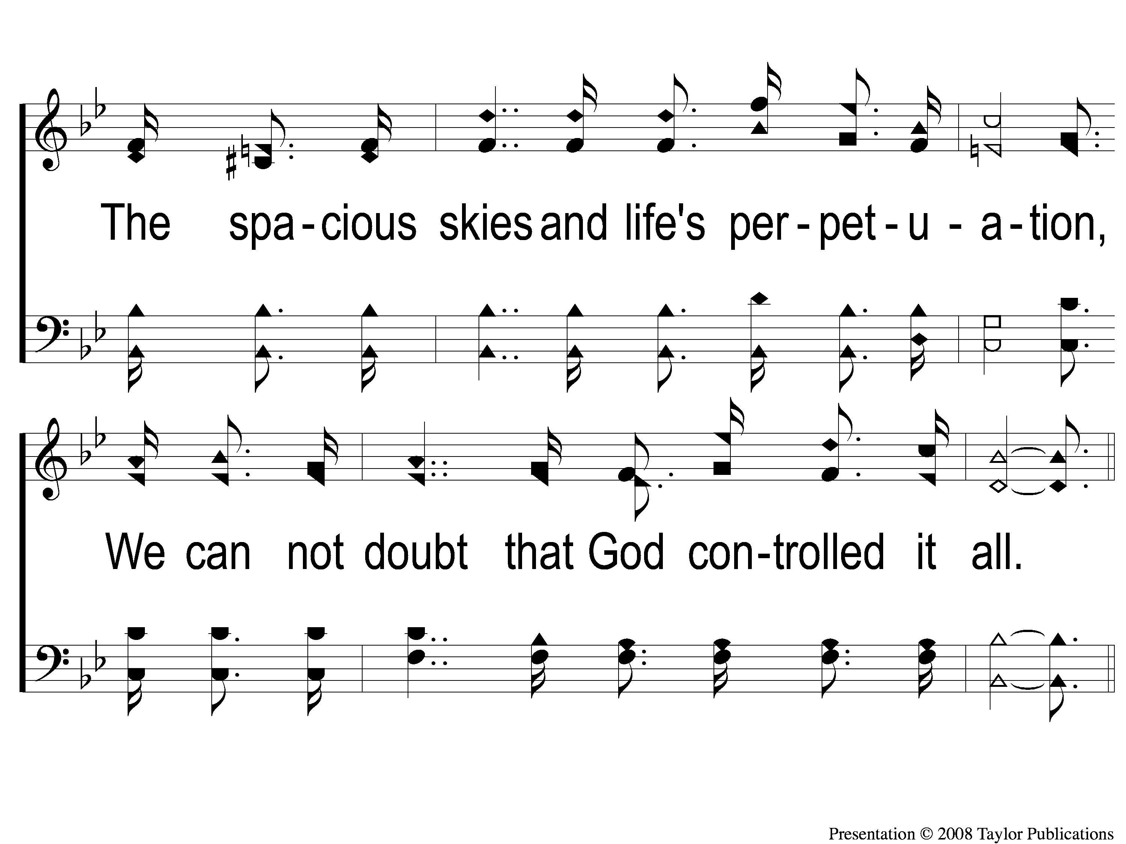
1-2 Lord I Believe
Lord, I Believe
75

Slide 3
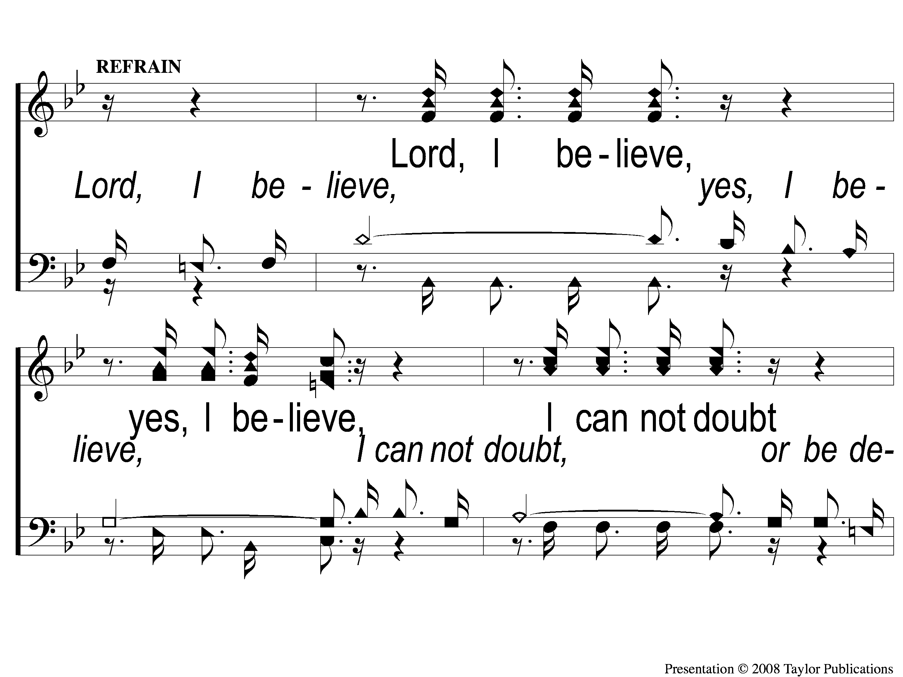
C-1 Lord I Believe
Lord, I Believe
75

Slide 4
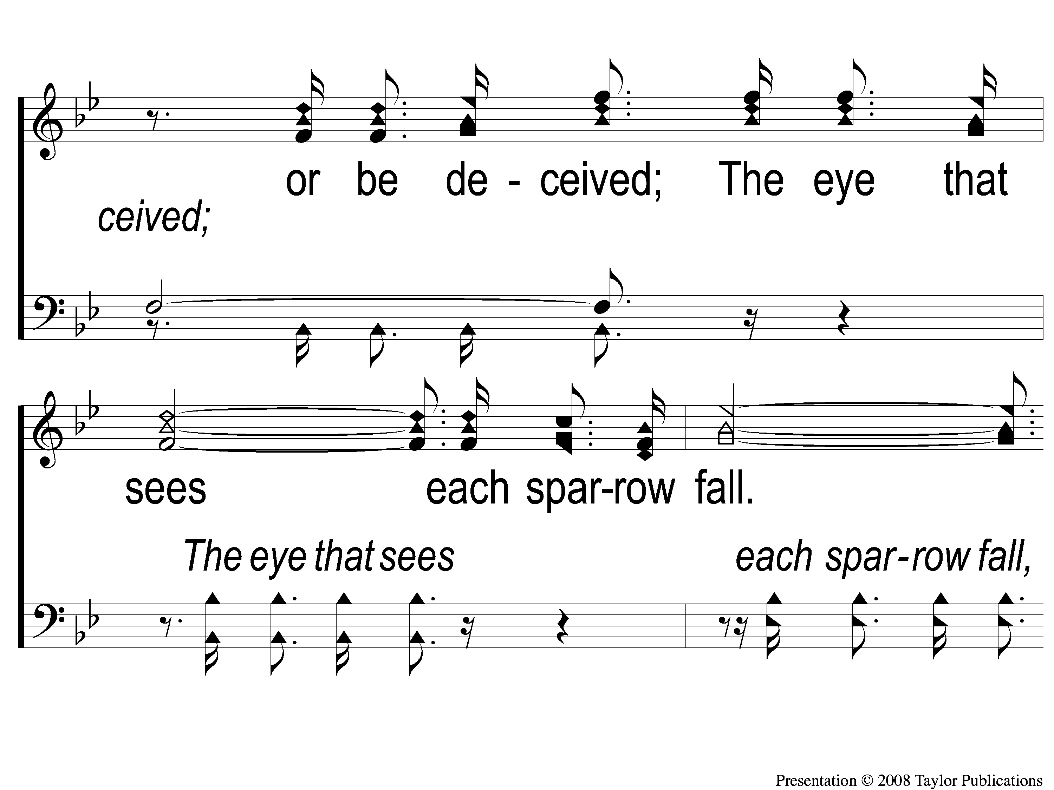
C-2 Lord I Believe
Lord, I Believe
75

Slide 5
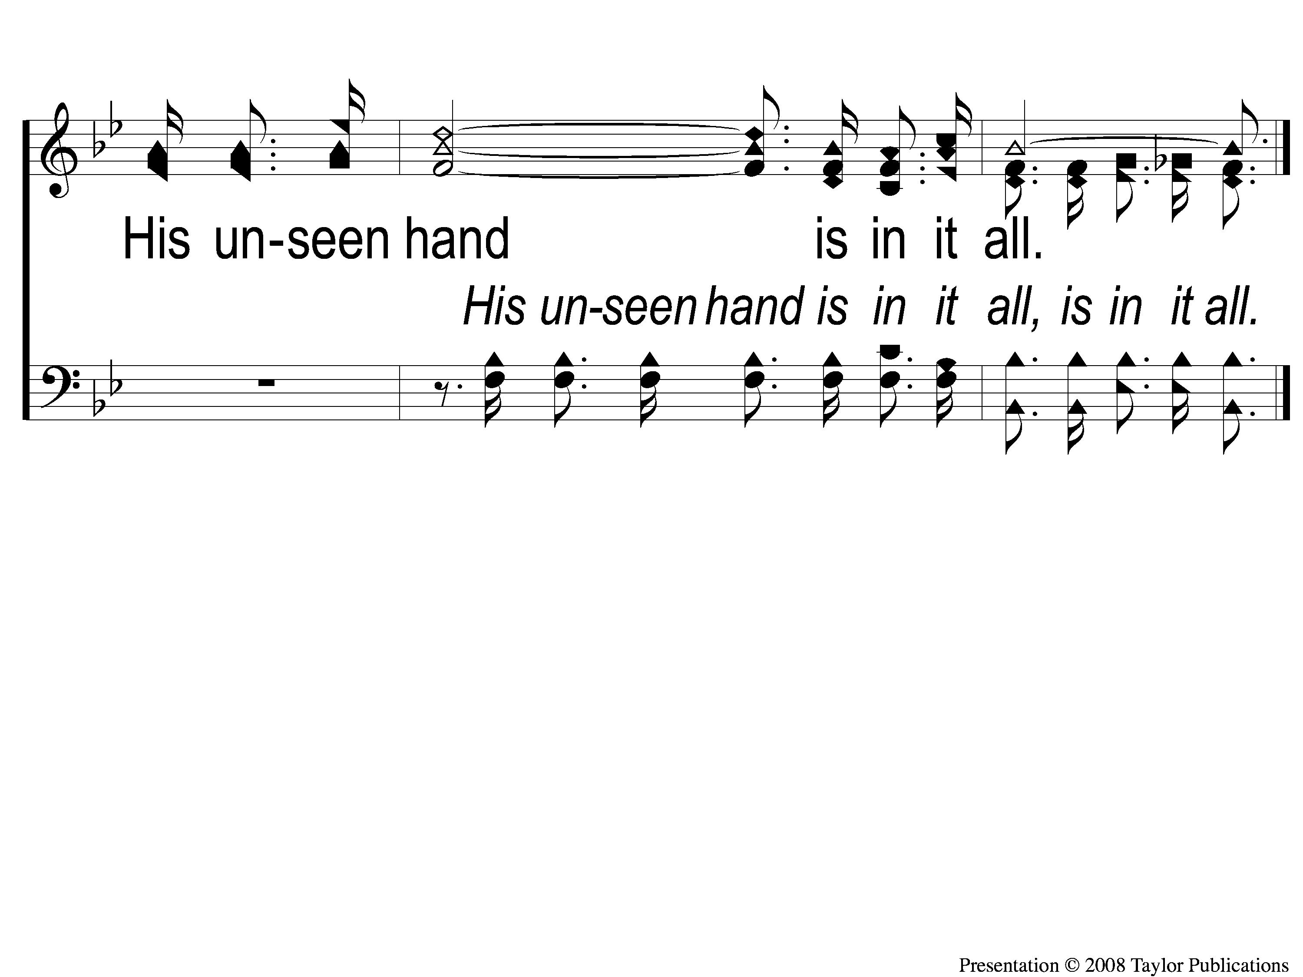
C-3 Lord I Believe
Lord, I Believe
75

Slide 6
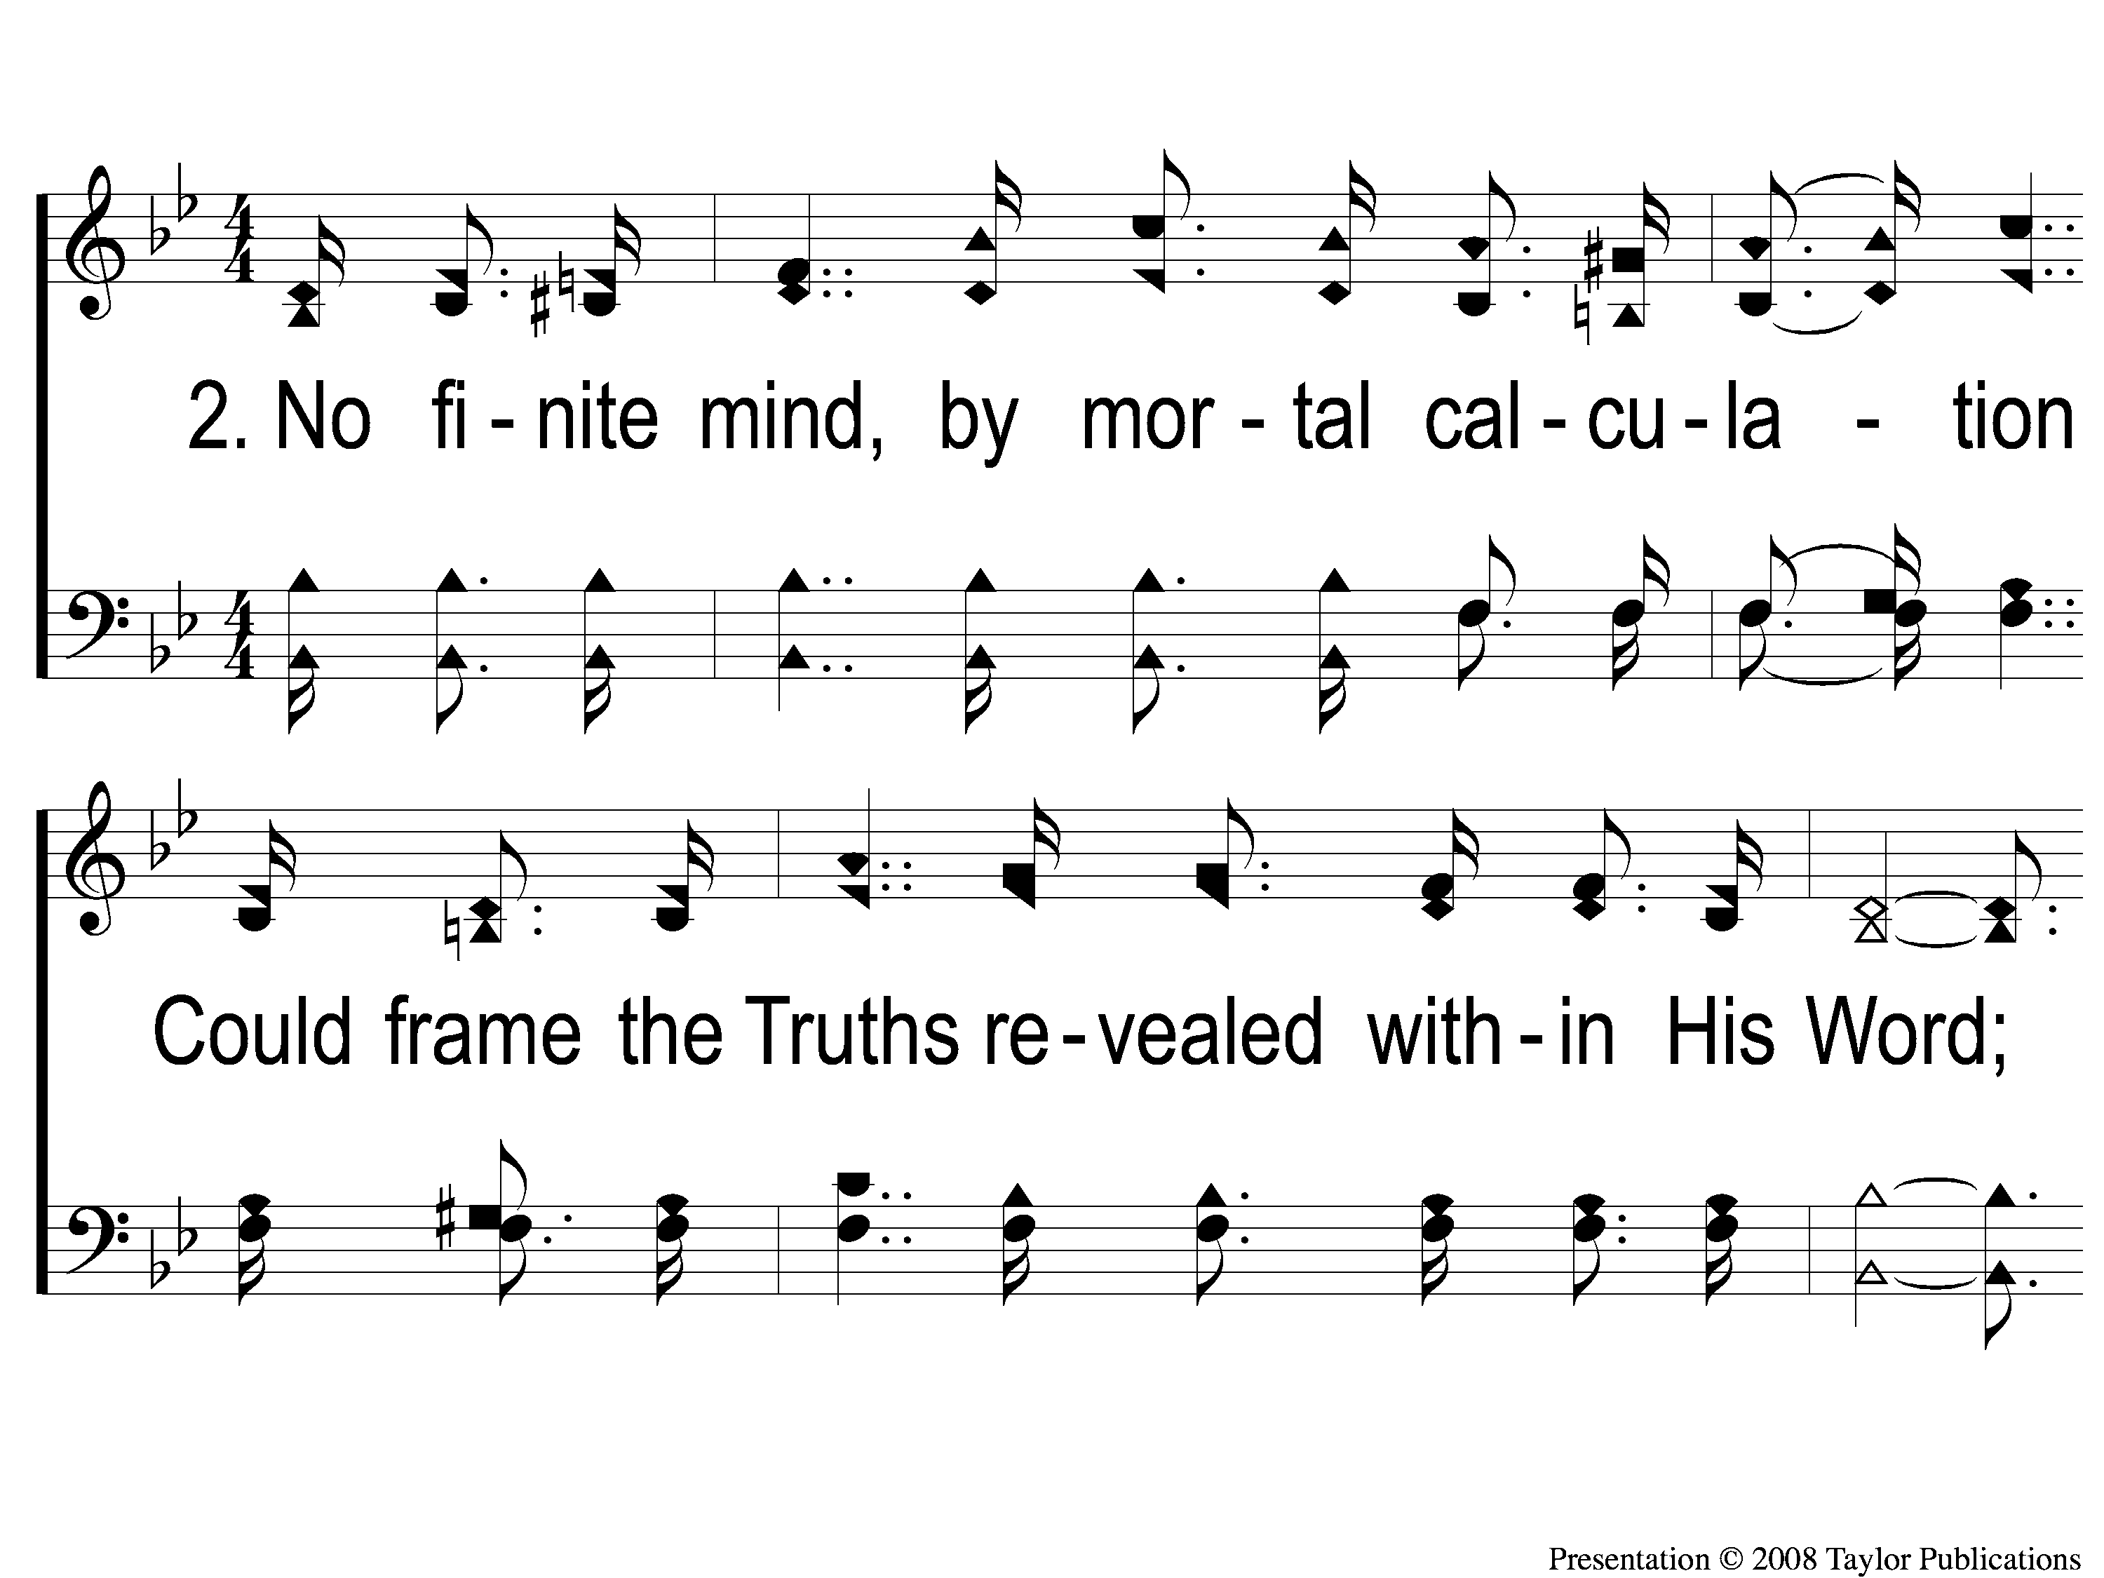
2-1 Lord I Believe
Lord, I Believe
75

Slide 7
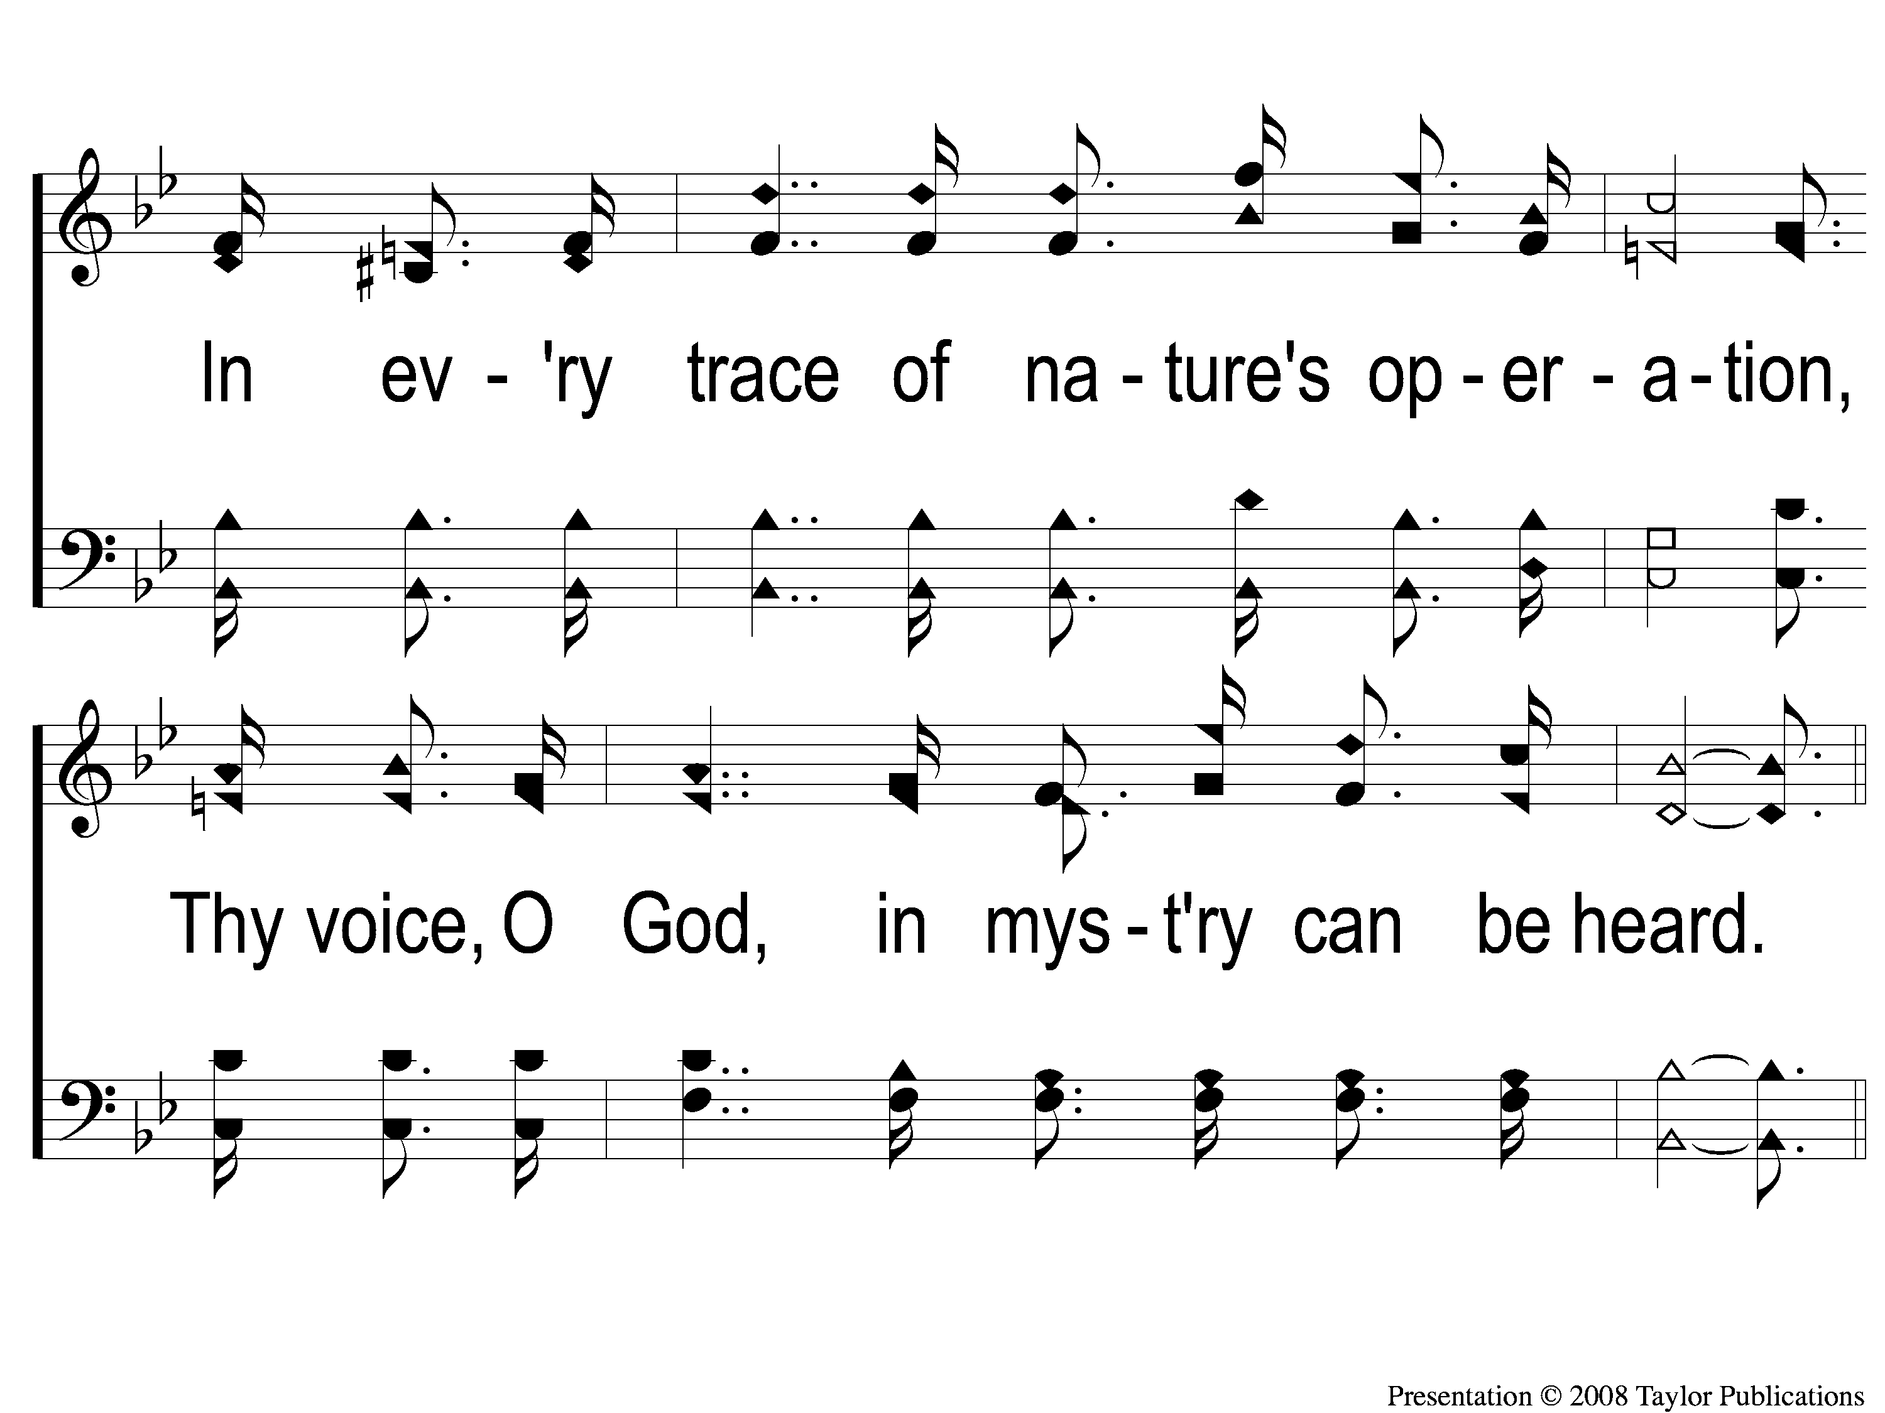
2-2 Lord I Believe
Lord, I Believe
75

Slide 8
C-1 Lord I Believe
Lord, I Believe
75

Slide 9
C-2 Lord I Believe
Lord, I Believe
75

Slide 10
C-3 Lord I Believe
Lord, I Believe
75

Slide 11
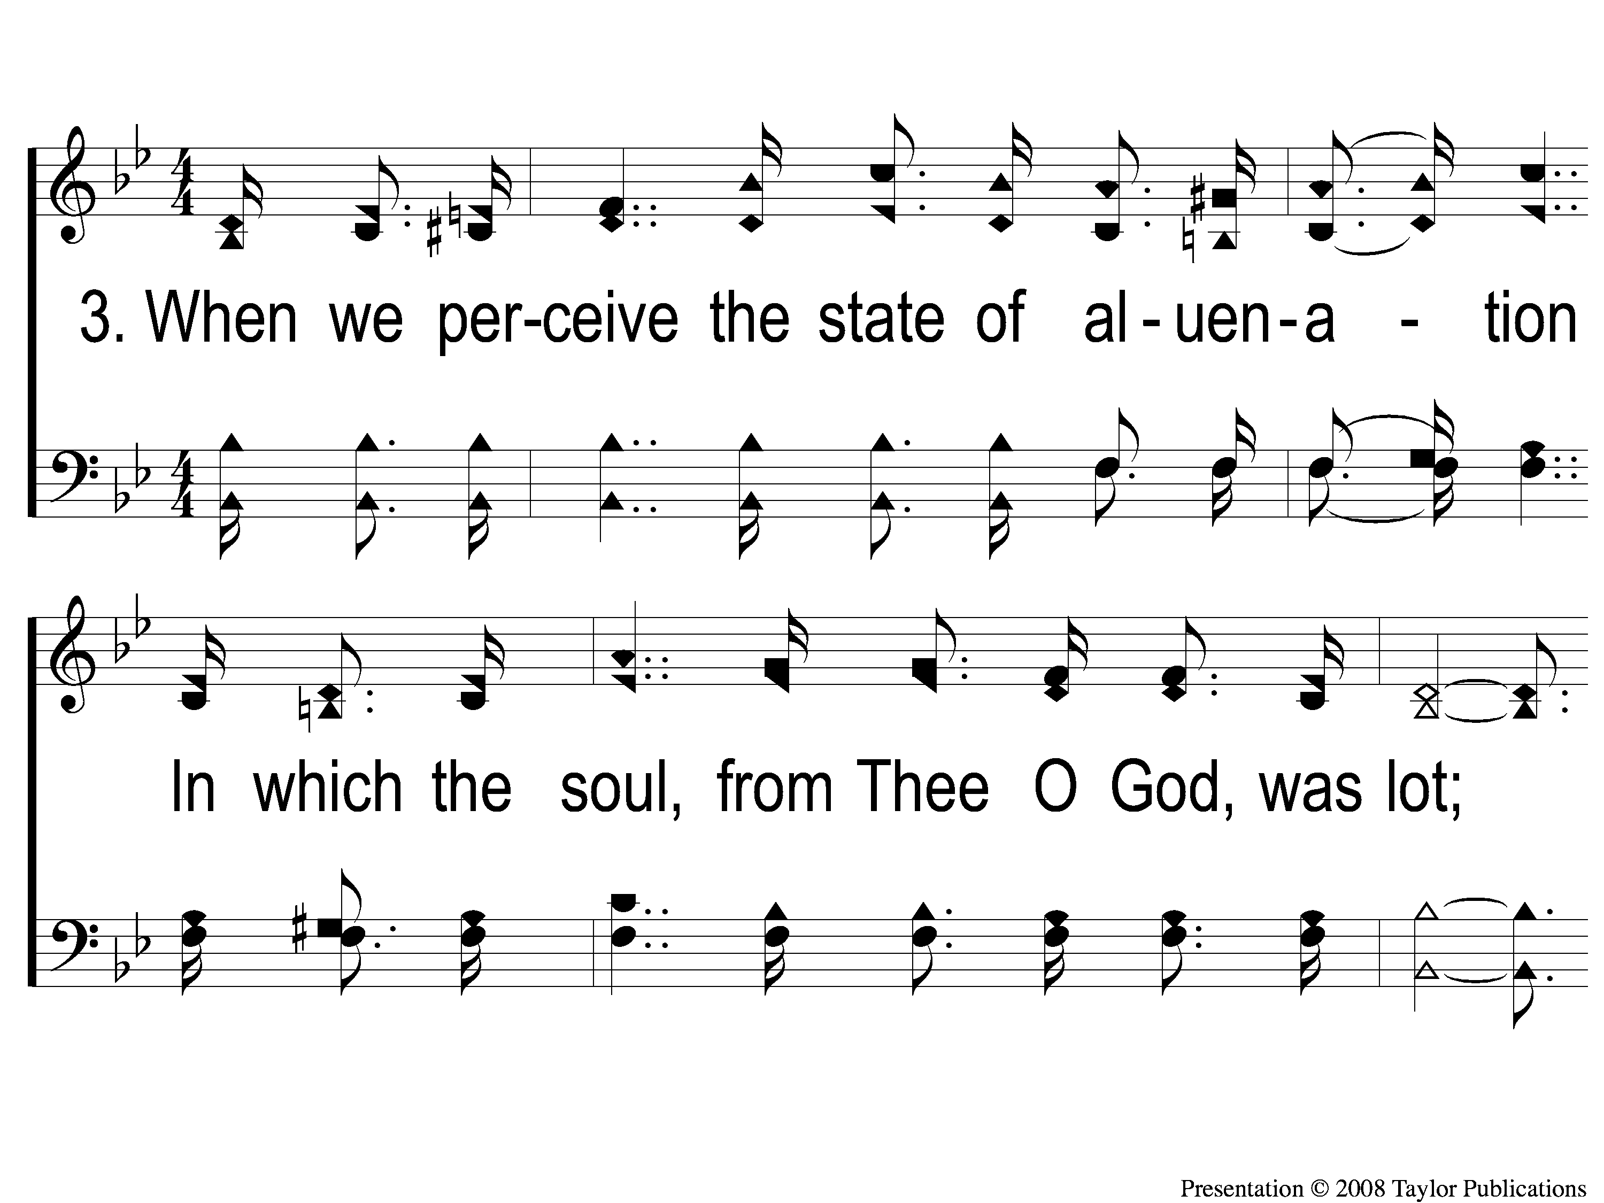
3-1 Lord I Believe
Lord, I Believe
75

Slide 12
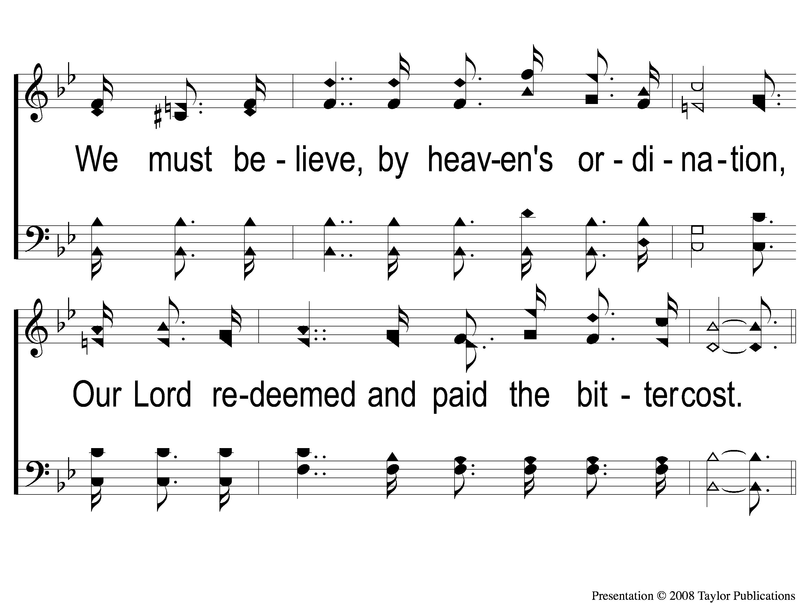
3-2 Lord I Believe
Lord, I Believe
75

Slide 13
C-1 Lord I Believe
Lord, I Believe
75

Slide 14
C-2 Lord I Believe
Lord, I Believe
75

Slide 15
C-3 Lord I Believe
Lord, I Believe
75

Slide 16
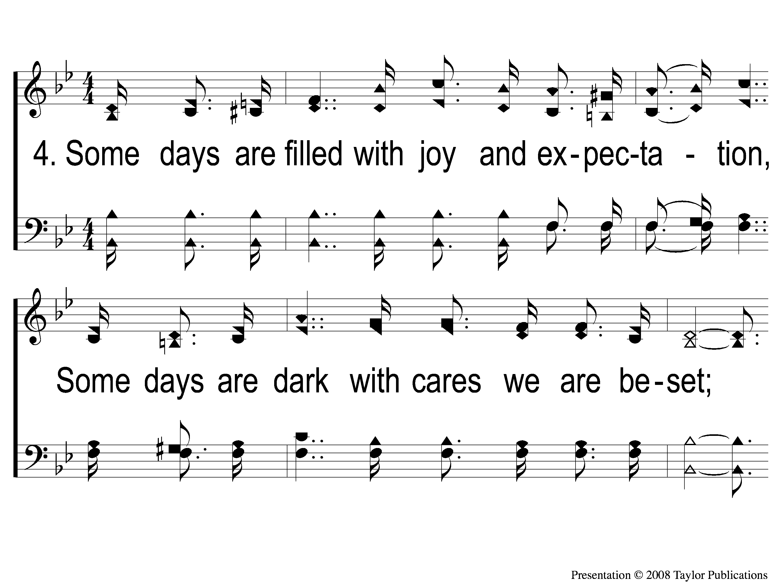
4-1 Lord I Believe
Lord, I Believe
75

Slide 17
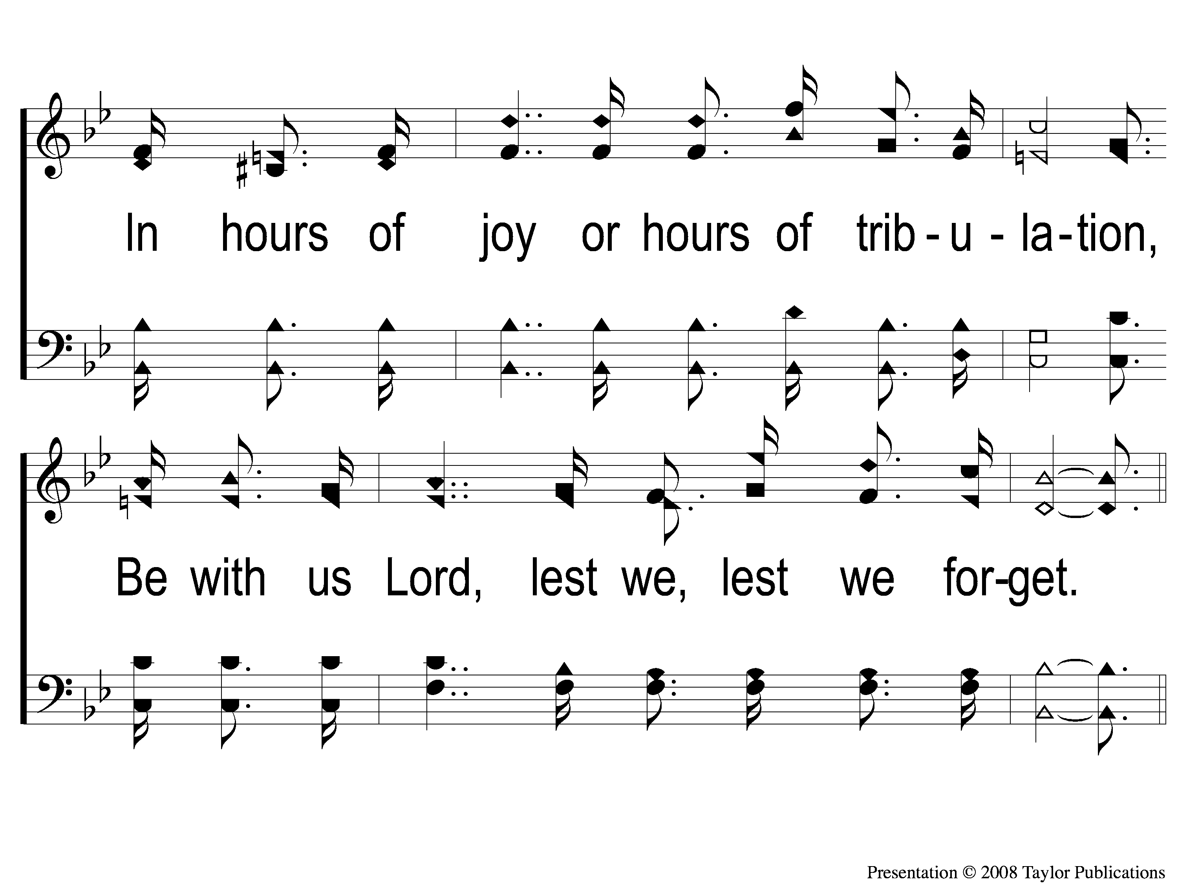
4-2 Lord I Believe
Lord, I Believe
75

Slide 18
C-1 Lord I Believe
Lord, I Believe
75

Slide 19
C-2 Lord I Believe
Lord, I Believe
75

Slide 20
C-3 Lord I Believe
Lord, I Believe
75

